Slide 1
Chapter 11: Advanced Personal Computers
IT Essentials: PC Hardware and Software v4.1
Notes:
Cisco Networking Academy program
IT Essentials: PC Hardware and Software v4.1
Chapter 11: Advanced Personal Computers

Slide 2
Chapter 11 Objectives
11.1 Give an overview of field, remote, and bench technician jobs
11.2 Explain safe lab procedure and tool use
11.3 Describe situations requiring replacement of computer components
11.4 Upgrade and configure personal computer components and peripherals
11.5 Identify and apply common preventive maintenance techniques for personal computer components
11.6 Troubleshoot personal computer components and peripherals
Notes:
Chapter 11 Objectives

Slide 3
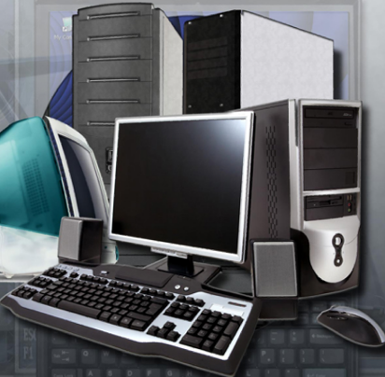
Personal Computers
A technician should be able to determine if a component for a customer's computer should be upgraded or replaced.
A technician should develop advanced skills in these areas:
  Installation procedures
  Troubleshooting techniques
  Diagnostic methods for computers.
Notes:
11.0 Chapter Introduction
This chapter discusses the importance of component compatibility across hardware and software. It also covers the need for adequate system resources to efficiently run the customer's hardware and software.

Slide 4
Computer Technicians
When training to become a computer technician, develop the following skills:
Building and upgrading computers
Performing installations
Installing, configuring, and optimizing software
Performing preventive maintenance
Troubleshooting and repairing computers
Communicating clearly with the customer
Documenting customer feedback and the steps involved in finding the solution to a problem
Notes:
11.1 Give an overview of field, remote, and bench technician jobs
Experience in working with computers and earning a technical certification can help a person become qualified for employment as any of the following:
Field technician
Remote technician
Bench technician
Technicians in different computer careers work in different environments. The skills required by each career can be very similar. The degree to which different skills are needed vary from one job to the next.

Slide 5
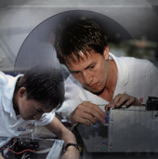

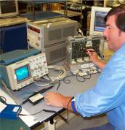
Field, Remote, and Bench Technicians
A field technician needs troubleshooting skills and customer service skills, because they work on-site, are in regular contact with customers and work on a wide variety of hardware and software.
A remote technician may work at a help desk answering calls or e-mails from customers who have computer problems and need good communication skills.
A bench technician may not work directly with customers. Bench technicians are often hired to perform computer warranty service in a central depot or work facility.
Notes:
11.1 Give an overview of field, remote, and bench technician jobs
Student Activity: The student course content includes the worksheet, 11.1 Job Opportunities. To complete this worksheet, students will conduct research on three jobs in the computer service and repair field. They should try to find jobs that require the same types of courses that they are presently taking. Be prepared to discuss in class.

Slide 6
Safety Rules
Keep work area clean and free of clutter.
Keep food and drinks out of work area.
Never open a computer monitor without proper training.
Remove all your jewelry and watches.
Make sure the power is off and the power plug has been removed.
Do not look into laser beams located in equipment.
Make sure there is a fire extinguisher and first aid kit available.
Cover sharp edges with tape when working inside computer case.
Notes:
11.2 Explain safe lab procedure and tool use
Safety should always be a technician’s priority on a job or in the lab. A computer technician should be aware of the many workplace hazards, and should take the necessary precautions to avoid them. They should practice safety in the lab so that it becomes part of their regular routine. Follow all safety procedures and use the correct tools for the job. This policy will help prevent personal injury and damage to equipment. To accomplish a safe working environment, it is better to be proactive rather than reactive.

Slide 7
Safe Working Environments
Always follow these basic rules:
Use antistatic mats and pads to reduce the chance of ESD damaging your equipment.
Store hazardous or toxic materials in a secured cabinet.
Keep the floor clear of anything that might trip someone.
Clean work areas on a regular basis.
Follow local codes and government rules whenever disposing of batteries, solvents, computers, and monitors.
Notes:
11.2.1 Review safe working environment and procedures
What are some of the documents that describe work safety codes and standards in your country?

Slide 8
Proper Tools
Use proper tools to work safely and prevent damage to the computer equipment.
  Various screwdrivers
  TORX screwdriver
  Tweezers or part retriever
  Needle-nosed pliers
  Wire cutters
  Chip extractor
  Hex wrench set
  Nut driver, large and small
  Three-claw component holder
  Digital multimeter
  Wrap plugs
  Small mirror
  Small dust brush
  Soft, lint-free cloth
  Cable ties
  Scissors
  Small flashlight
  Electric tape
  Pencil or pen
  Compressed air
  Antistatic wrist strap
  Antistatic mat
  Antistatic bag
  Cleaning products
Notes:
11.2.2 Review names, purposes, characteristics, and safe and appropriate use of tools
Various specialty tools, such as Torx bits, antistatic bags and gloves, and integrated circuit pullers, can be used to repair and maintain computers. Always avoid magnetized tools, such as screwdrivers with magnetic heads, or tools that use extension magnets to retrieve small metal objects that are out of reach. Using magnetic tools can cause loss of data on hard drives and floppy disks. Magnetic tools can also induce current, which can damage internal computer components.
Static electricity is one of the biggest concerns for computer technicians when working in many environments. The tools you use and even your own body can store or conduct thousands of volts of electricity. Walking across carpet or a rug and touching a computer component before grounding yourself can severely damage the component. Antistatic devices help control static electricity. Use antistatic devices to prevent damage to sensitive components. Before you touch a computer component, be sure to ground yourself by touching a grounded computer chassis or mat. These are some antistatic devices:
Antistatic wrist strap – Conducts static electricity from your body to ground
Antistatic mat – Grounds computer frame
Antistatic bag – Keeps sensitive computer components safe when not installed inside a computer
Cleaning products – Maintains components without creating a buildup of static electricity
CAUTION: Do not wear an antistatic wrist strap when working with high-voltage circuits, such as those found in monitors and printers. Do not open monitors unless you are properly trained.

Slide 9
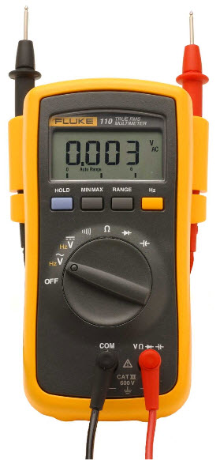
Specialized Testing Devices
Specialized testing devices are used to diagnose computer and cable problems
  Multimeter – Measures AC/DC voltage, electric current, and other cable and electrical characteristics.
  Power supply tester – Checks whether the computer power supply is working properly.
  Cable tester – Checks for wiring shorts or faults, such as wires connected to the wrong pin.
  Loopback plug – Connects to a computer, hub, switch, or router port to perform a diagnostic procedure to test the integrity of the data transmission.
Notes:
11.2.2 Review names, purposes, characteristics, and safe and appropriate use of tools
Student Activity: The student course content includes two labs:
11.2.2 Lab: Using a Multimeter and a Power Supply Tester . To complete this lab the stuent will learn ht to use and handlre a multimeter and a power supply tester.
11.2.2 Lab: Testing UTP Cables using a Loopback Plug and a Cable Meter. To complete this lab the student will use a loopback plug and a cable meter to test an Ethernet cable.

Slide 10

High Voltage Computer Components
The following dangerous, high-voltage computer components should only be serviced by authorized personnel:
Power supplies - Most broken or used power supplies are replaced.
Display monitors - The internal electronic parts of a display monitor cannot be repaired, but they can be replaced.
Laser printers - It is more cost effective
to fix broken printers by repairing or
replacing broken parts. Laser printers
use high voltages and may have very
hot surfaces inside.
Notes:
11.2.3 Identify potential safety hazards and implement proper safety procedures for computer components
Most internal computer components use low-voltage electricity. Some components, however, operate with high voltage and can be dangerous if you do not follow safety precautions.

Slide 11
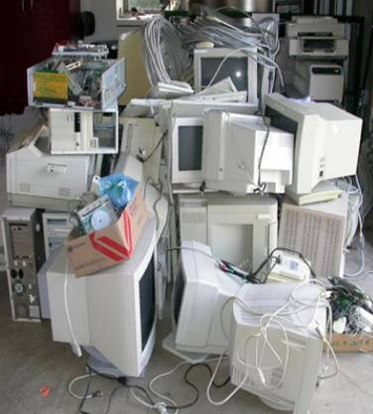
Environmental Issues
A computer recycling warehouse is a place where discarded computer equipment can be taken apart.
Computer parts that are still usable can be recycled for repairing other equipment.
Many organizations have policies that define disposal methods for the hazardous components found in electronic equipment.
Notes:
11.2.4 Describe environmental issues
Before parts are recycled, they are separated into groups. CRT monitors contain as much as 4 to 5 lbs (1.6 to 2.3 kg) of lead, a dangerous element. Much of the lead is inside cathode ray tubes. Other materials inside computer equipment are also dangerous:
Mercury
Cadmium
Hexavalent chromium
Batteries are used to power laptop computers, digital cameras, camcorders, and remote-control toys. Batteries may contain some of these toxic materials:
Nickel cadmium (Ni-Cd)
Nickel metal hydride (Ni-MH)
Lithium ion (Li-ion)
Lead (Pb)
Discarding Components - These methods typically include programs to reuse, recycle, or exchange. A technician may need to dispose of computer components because they have become outdated. In addition to recycling parts, you can donate them to other people or organizations. Some businesses exchange used computer equipment for partial payment of new equipment.

Slide 12
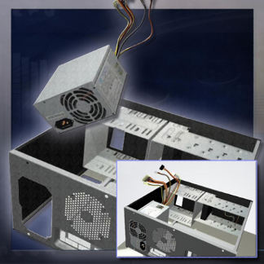
Select a Case and Power Supply
Determine the customer's needs
before making any purchases or
performing upgrades.
  A power supply should support
  25 percent more wattage than all the
  attached components require.
The computer case holds the power
supply, motherboard, memory, and
other components.
When purchasing a new computer case and power supply separately, ensure that all of the components will fit into the new case and that the power supply is powerful enough to operate all of the components.
Notes:
11.3.1 Select a case and power supply
Situations that require the replacement of computer components include the repair of broken parts or an upgrade for functionality.
Many times a case comes with a power supply inside. Verify that the power supply provides enough power to operate all the components that will be installed in the case.
Power supplies convert AC input to DC output voltages. Power supplies typically provide voltages of 3.3, 5, and 12 V, and are measured in wattage. It is recommended that the power supply has approximately 25 percent more wattage than all the attached components require. Determine the total wattage required by adding together the wattage for each component in the computer. If the wattage is not listed on a component, calculate it by multiplying the voltage and amperage of the component. If the component requires different levels of wattage, use the higher required wattage. After determining the wattage required for the power supply, ensure that the power supply has the required connectors for all of the components.

Slide 13
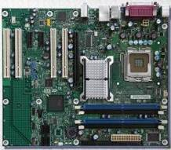
Select a Motherboard
When you select a replacement motherboard, make sure it supports the CPU, RAM, video adapter, and other adapter cards.
The socket and chip set on the motherboard must be compatible with the CPU.
The motherboard must accommodate the existing heat sink/fan assembly.
The existing power supply must have connections that fit the new motherboard.
The number and type of expansion slots
must match the existing adapter cards.
The new motherboard must physically
fit into the current computer case.
Notes:
11.3.2 Select a motherboard
The new motherboard may lack an AGP connector for an existing video adapter. The motherboard may have PCIe expansion slots that the existing adapter cards cannot use.
Different motherboards use different chipsets. A chipset consists of integrated circuits, which allows the CPU to communicate and interact with the other components of the computer. The chipset establishes how much memory can be added to a motherboard and the type of connectors on the motherboard. When building a computer, choose a chipset that provides the capabilities that you need. For example, you can purchase a motherboard with a chipset that enables multiple USB ports, eSATA connections, surround sound, or basic video.
Motherboards have different types of CPU sockets and CPU slots that are determined by the chipset. This socket or slot provides the connection point and the electrical interface for the CPU. The CPU package must match the motherboard socket type or CPU slot type. A CPU package contains the CPU, connection points, and materials that surround the CPU and dissipate heat.
Data travels from one part of a computer to another through a collection of wires known as the bus. The bus has two parts. The data portion of the bus, known as the data bus, carries data between components of a computer. The address portion of the bus, known as the address bus, carries the memory addresses of the locations where data is read or written by the CPU.
The bus size refers to the width of the bus. The bus size determines how much data can be transmitted at one time. A 32-bit bus transmits 32 bits of data at one time from the processor to RAM or to other motherboard components, while a 64-bit bus transmits 64 bits of data at one time. The speed at which data travels through the bus is determined by the clock speed, measured in MHz.
PCI expansion slots connect to a parallel bus, which sends multiple bits over multiple wires simultaneously. PCI expansion slots are being replaced with PCIe expansion slots that connect to a serial bus, which sends one bit at a time at a faster rate. When building a computer, choose a motherboard that has slots to meet your current and future needs. For example, if you are building a computer for advanced gaming that needs dual graphics cards, you might choose a motherboard with dual PCIe slots.
Motherboards have expansion slots, which provide a connection point on the motherboard where a circuit board can be attached to add new capabilities to the computer. Expansion slots are used to add a variety of capabilities, such as video adapters, TV tuner cards, video capture cards, and NICs.

Slide 14
Select CPU
Replace the CPU when it fails or is no longer adequate for the current applications.
Make sure the CPU is compatible with the existing motherboard:
  The new CPU must use the same socket type or slot type and chip set.
  The BIOS must support the new CPU.
  The new CPU may require a different heat sink/fan assembly.
  Make sure the correct voltage is maintained.
  Use manufacturers' websites to investigate the compatibility between CPUs and other devices.
Notes:
11.3.3 Select the CPU and heat sink/fan assembly
Manufacturers' websites are a good resource to investigate the compatibility between CPUs and other devices. A voltage regulator module (VRM) is integrated into the motherboard. The voltage setting for the CPU can be configured with jumpers or switches located on the motherboard.

Slide 15
CPU Features and Classification
Multi-core processors - RAM is shared between the processors
Cache memory - L1, L2 and L3
Speed of a processor - Maximum speed without errors
Front Side Bus (FSB) - Path between the CPU and chip set, expansion cards, and RAM
32-bit and 64-bit - number of instructions handled by the processor at one time
Notes:
11.3.3 Select the CPU and heat sink/fan assembly
Multi-core processors have two or more processors on the same integrated circuit. Multi-core processors execute instructions more quickly and have increased data throughput than single-core processors. A multi-core processor is recommended for applications such as video editing, gaming, and photo manipulation.
High power consumption creates more heat in the computer case. Multi-core processors conserve power and produce less heat than multiple single-core processors, thus increasing performance and efficiency.
Processors have areas of fast memory designed to increase the speed and performance of the processor. When this area of memory is located inside the processor, it is the primary, or Level 1 (L1), cache. Cache memory external to the processor is Level 2 (L2) cache. Starting with the Pentium Pro and later processors, the L2 cache was included in the processor architecture. After the L2 cache was added to the processor, the extra cache installed on the motherboard was named Level 3 (L3). These CPU caches are much faster than the main memory.
Two primary factors can limit the speed of a processor:
The processor chip is a collection of transistors interconnected by wires. There are delays created by the transmission of data flowing through the transistors and wires.
As the transistors change state, from on to off or off to on, small amounts of electricity are released. The amount of heat generated increases as the speed of the processor increases. When the processor becomes too hot, it will begin to produce errors.
Data can travel in both directions across the FSB. The frequency of the bus is measured in megahertz (MHz). The frequency at which a CPU operates is determined by applying a clock multiplier to the FSB speed. For example, a processor running at 3200 MHz might be using a 400 MHz FSB. 3200 MHz divided by 400 MHz is 8. In this example, the CPU is 8 times faster than the FSB.
A 64-bit processor processes more instructions per clock cycle than a 32-bit processor. A 64-bit processor can also support much more memory than a 32-bit processor. To use the 64-bit processor capabilities, ensure that the operating system installed supports a 64-bit processor and applications are compatible.

Slide 16
Select a Heat Sink/Fan and Case Fan
Heat sink/fan assembly considerations:
  Socket type
  Motherboard physical specifications
  Case size
  Physical Environment
Case fan considerations:
  Case size
  Fan speed
  Number of components in the case
  Physical environment
  Number of mounting places available
  Location of mounting places available
  Electrical connections
Notes:
11.3.3 Select the CPU and heat sink/fan assembly
The CPU can become very hot. Many CPUs require a heat sink, combined with a fan for cooling. A heat sink is a piece of copper or aluminum that sits between the processor and the CPU fan. The heat sink absorbs the heat from the processor and then the fan disperses the heat.
Socket type – The heat sink or fan type must match the socket type of the motherboard.
Motherboard physical specifications – The heat sink or fan must not interfere with any components attached to the motherboard.
Case size – The heat sink or fan must fit within the case.
Physical environment – The heat sink or fan must be able to disperse enough heat to keep the CPU cool in warm environments.
Case fans should be installed to move cooler air into the case while moving heat out of the computer case.
Case size – Larger cases often require larger fans because smaller fans cannot create enough air flow.
Fan speed – Larger fans spin more slowly than smaller fans, which reduce fan noise.
Number of components in the case – Multiple components in a computer create additional heat, which requires more fans, larger fans, or faster fans.
Physical environment – The case fans must be able to disperse enough heat to keep the interior of the case cool.
Number of mounting places available – Different cases have different numbers of mounting places for fans.
Location of mounting places available – Different cases have different locations for mounting fans.
Electrical connections – Some case fans are connected directly to the motherboard while others are connected directly to the power supply.
Note: The direction of air flow created by all the fans in the case must work together to bring the cooler air in while moving the hotter air out. Installing a fan backwards or using fans with the incorrect size or speed for the case can cause the air flows to work against each other.

Slide 17
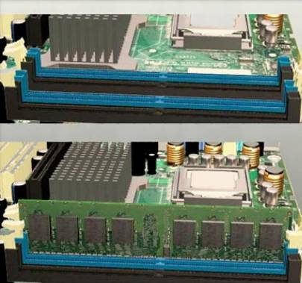
Select RAM
New RAM may be needed when an application locks up or the computer displays frequent error messages.
When selecting new RAM, check the compatibility with the current motherboard.
The speed of the new RAM must be the same or faster than the existing RAM.
Notes:
11.3.4 Select RAM
To determine if the problem is the RAM, replace the old RAM module. Restart the computer to see if the application runs properly.
NOTE: To close a stalled application, press Ctrl-Alt-Delete to open the Task Manager. In the window, select the application. Click End Task to close it.
When selecting new RAM, you must ensure that it is compatible with the current motherboard. It must also be the same type of RAM as installed in the computer. The speed of the new RAM must be the same or faster than the existing RAM. It may help to take the original memory module with you when you shop for the replacement RAM.

Slide 18
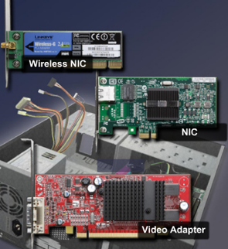
Select Adapter Cards
Adapter (or expansion) cards, add extra functionality to a computer. Before purchasing an adapter card, check:
    Is there an open expansion slot?
    Is the adapter card compatible with the open slot?
    What are the customer’s current and future needs?
    What are the possible configuration options?
    What are the reasons for the best choice?
If the motherboard does not have compatible expansion slots, external devices are an option:
  Are USB or FireWire versions of the external device available?
  Does the computer have an open USB or FireWire port?
Notes:
11.3.5 Select adapter cards
Consider the following situation for an adapter card upgrade. A customer requires a wireless card to connect to the network. The new wireless adapter card must be compatible with the existing wireless network and with the computer.
Investigate wireless NICs before you purchase one.
You should ensure that the new wireless NIC is compatible with the 802.11 wireless standard being used on the wireless network.
Examine the computer for an available expansion slot or an open USB port.
Purchase either an adapter card that will fit an available expansion slot or a USB wireless NIC.
Cost, warranty, brand name, and availability are the last factors for you to consider
Graphics Cards
Factors to consider when purchasing a new graphics card:
Slot type
Port types
Amount and speed of Video RAM (VRAM)
Graphics Processor Unit (GPU)
Maximum resolution
Frames per second
Sound Cards
Factors to consider when purchasing a new sound card:
Slot type
Digital Signal Processor (DSP)
Sample rate
Port and connection types
Hardware decoders
Signal-to-noise ratio
Storage Controllers
Factors to consider when purchasing a new storage controller card:
Slot type
Drive type
Connector quantity
Connector location
Card size
Controller card RAM
Controller card processor
RAID types
Input/Output Cards (I/O)
Factors to consider when purchasing an I/O card:
Slot type
I/O port type
I/O port quantity
Additional power requirements
NICs
Factors to consider when purchasing a NIC:
Slot type
Speed
Connector type
Connection type
Standards compatibility
Wake on LAN
Capture Cards
Factors to consider when purchasing a capture card:
Slot type
Resolution and frame rate
I/O ports
Format standards

Slide 19
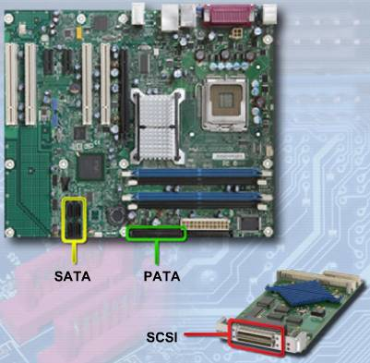
Storage Device Failures
The signs that a hard drive is failing and should be replaced as soon as possible:
  Unusual noises
  Error messages
  Corrupt data or
  applications
Replacement options:
  Floppy Disk Drive
  Media Reader
  Solid State Drives
  Optical Drives
  External Storage
  Hard Drive
Notes:
11.3.6 Select storage devices and hard drives
Floppy Disk Drive (FDD)
If an existing FDD fails, replace it with one of the newer storage devices.
Media Readers
Factors to consider when purchasing a new media reader:
Internal or external
Type of connector used
Type of media cards supported
Solid State Drives
Factors to consider when purchasing an SSD:
Cost
Adding or replacing
Internal or external
Case location
System compatibility
Power requirements
Speed
Capacity
Optical Drives
Factors to consider when purchasing an optical drive:
Interface type
Reading capabilities
Writing capabilities
Formats
External Storage
Factors to consider when purchasing external storage:
Port type
Storage capacity
Speed
Portability
Power requirements

Slide 20
Hard Drive Connectors
PATA (Parallel ATA) hard drives
  Originally, called ATA (Advanced Technology Attachment).
  With the introduction of SATA, ATA was renamed to PATA.
  Can use a 40-pin / 80-conductor cable or a 40-pin / 40-conductor cable.
SATA (Serial ATA) hard drives
  Connect to the motherboard using a serial interface.
  Have a higher data-transfer rate than PATA drives.
  Smaller data cable allows for improved airflow.
SCSI (Small Computer Systems Interface) hard drives
  More advanced interface controller than PATA or SATA.
Notes:
11.3.6 Select storage devices and hard drives

Slide 21
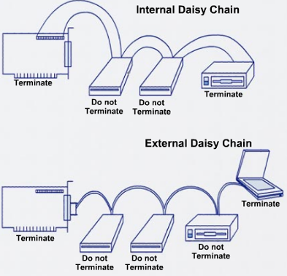
Small Computer Systems Interface (SCSI)
Usually used for hard drives and for tape storage
Ideal for high-end computers,
including network servers that
require high transfer speeds
and reliability
SCSI devices are connected in
a series, forming a chain that is
called a daisy chain.
Each end of the daisy chain is
terminated to prevent signal
reflections and interference.
Most SCSI buses can handle a total of seven devices and a SCSI controller.
Each device must have a unique SCSI ID.
Notes:
11.3.6 Select storage devices and hard drives
SCSI is a more advanced interface controller than PATA or SATA. Devices may include hard drives, CD-ROM drives, tape drives, scanners, and removable drives.
Generally, the SCSI controller on one end of the SCSI bus has onboard termination. The other end of the SCSI cable is either terminated by a resistor on the last drive on the chain or a physical terminator on the end of the SCSI bus.
Most SCSI buses can handle a total of seven devices and a SCSI controller. The channels are numbered from 0 through 7. Some versions of SCSI support a total of 15 devices plus the SCSI controller. These channels are numbered 0 through 15. Each device on a SCSI channel must have a unique SCSI ID. For example, the primary drive would be 0, and the controller card is usually 7. The SCSI ID is generally set by jumpers on a SCSI drive.

Slide 22
SCSI Types
SCSI Type | Also Called | Connector | Maximum Throughput
SCSI-1 |  | 50-pin Centronics 50-pin | 5 MBps
Fast SCSI | Plain SCSI | 50-pin Centronics 50-pin | 10 MBps
Fast Wide SCSI |  | 50-pin 68-pin | 20 MBps
Ultra SCSI | Fast-20 | 50-pin | 20 MBps
Ultra Wide SCSI |  | 68-pin | 40 MBps
Ultra2 SCSI | Fast-40 | 50-pin | 40 MBps
Ultra2 Wide SCSI |  | 68-pin 80-pin | 80 MBps
Ultra3 SCSI | Ultra-160 | 68-pin 80-pin | 160 MBps
Ultra320 SCSI |  | 68-pin 80-pin | 320 MBps
Notes:
11.3.6 Select storage devices and hard drives
The SCSI bus was originally 8-bits wide and operated at a transfer rate of 5 MBps. Later SCSI technologies used a 16-bit bus and operated at 320 – 640 MBps. Current and future SCSI technologies use a serial interface for increased speed.
[Clarify the difference between MBps and Mbps. Megabytes per second (MBps) describes a unit of data transfer to and from a computer storage device. Mbps stands for millions of bits per second or megabits per second and is a measure of bandwidth (the total information flow over a given time) on a telecommunications medium.]

Slide 23
Select Input and Output (I/O) Devices
An input device transfers information into a computer:
  Mouse
  Keyboard
  Scanner
  Camera
  Process control sensor
  MIDI interface
  Microphone
An output device transfers information out of a computer:
  Display monitor
  Projector
  Printer
  Process-control equipment
  Speaker
Notes:
11.3.7 Select input and output devices

Slide 24
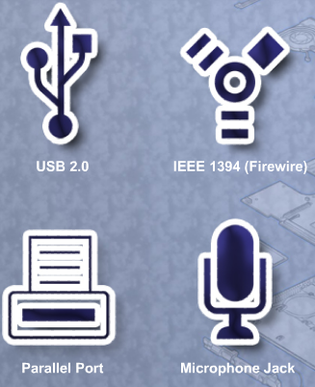
Types of I/O Device Interfaces
USB 1.1 - Transfers data up to 12 Mbps
USB 2.0 - Transfers data up to 480 Mbps
IEEE 1394 (FireWire) - Transfers data at 100, 200, or 400 Mbps
Parallel (IEEE 1284) - Transfers data up to 3 MBps
Serial (RS-232) - Early versions: less than 20 Kbps. Now: up to 1.5 Mbps
SCSI (Ultra-320 SCSI) - Connects as many as 15 devices at 320 MBps
Notes:
11.3.7 Select input and output devices
Student Activity: The student course content includes the worksheet, 11.3.7 Research Computer Components. To complete this worksheet, students will conduct research for information about the components needed for specific computer upgrades.

Slide 25
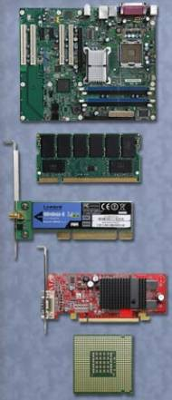
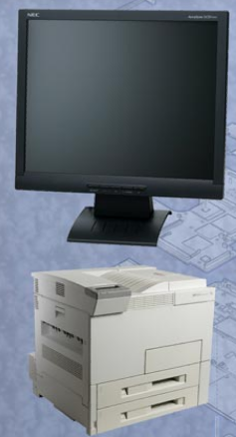
Upgrade Components and Peripherals
Computer systems need periodic upgrades:
  User requirements change
  Upgraded software packages require new hardware
  New hardware offers enhanced performance
  Research the effectiveness and cost for both upgrading and replacing
Notes:
11.4 Upgrade and configure personal computer components and peripherals

Slide 26
Upgrade and Configure Motherboards
Work on an antistatic mat and wear a wrist strap.
Note where and how everything is connected before you upgrade.
Move the CPU and heat sink/fan assembly to the new motherboard.
Use thermal compound between the CPU and the heat sink.
Connect jumper setting to support motherboard options
    CPU voltage, CPU speed, Bus speed, Cache size and type, Flash BIOS enabled, Clear CMOS, Size of system memory
If new RAM is required, install it at this time.
If the CMOS battery needs to be replaced, ensure that it is the correct model required by the motherboard.
Remove the cables from the old motherboard that attach to the case LEDs and buttons, then remove the motherboard.
Replace the old I/O shield if the new motherboard has different I/O ports or port locations.
Notes:
11.4.1 Upgrade and configure a motherboard
To upgrade or replace a motherboard, you may have to replace several other components, such as the CPU, heat sink/fan assembly, and RAM. A new motherboard must fit into the old computer case. The power supply must also be compatible for the new motherboard and be able to support all new computer components.
The CPU and heat sink/fan assembly are much easier to work with when they are outside of the case.
Jumper Settings
Jumpers are upright gold pins on the motherboard. Each grouping of two or more pins is called a jumper block. A motherboard might use a Dual In-line Package (DIP) switch instead of jumpers. Both methods are used to complete electrical circuits which provide a variety of options supported by the motherboard. The motherboard manual indicates which pins should be connected or not connected to accommodate the various options.
Note how the motherboard secures to the case. Some mounting screws provide support, and some may provide an important grounding connection between the motherboard and chassis. In particular, you should pay attention to screws and standoffs that are non-metallic. These may be insulators. Replacing insulating screws and supports with metal hardware that conducts electricity may have disastrous results.

Slide 27
Upgrade and Configure Motherboards (Continued)
Install the new motherboard, make sure to use the correct screws.
Connect the power supply cables.
Connect the cables for the case LEDs and buttons.
Install and secure all expansion cards.
Make sure there are no loose parts or leftover wires.
Connect the keyboard, mouse, monitor, and power.
Use the documentation that came with the motherboard to learn what BIOS adjustments may be required.
CAUTION: If there is any sign of trouble, shut the power supply off immediately.
Notes:
11.4.1 Upgrade and configure a motherboard
Do not swap threaded screws with self-tapping metal screws; they will damage the threaded screw holes and may not be secure. Make sure that threaded screws are the correct length and have the same number of threads per inch. If the thread is correct, they will fit easily. You may make a screw fit by using force, but you will damage the threaded hole and it will not hold the motherboard securely. Using the wrong screw can also produce metal shavings that can cause short circuits.
NOTE: It does not matter if you replace a screw made for a slotted screwdriver with one made for a Phillips-head screwdriver, as long as the threaded part of the screw is the same length and has the same number of threads.
If the ATX power connectors are not the same size (some have more pins), you may need to use an adapter. Connect the cables for the case LEDs and buttons.
NOTE: If an LED or button does not work, the wire to the motherboard is probably connected improperly.
Do not forget that an expansion card can have the same functionality that is integrated into the motherboard. In this case, you may need to disable the onboard functions in the system BIOS. Use the documentation that came with the motherboard to learn what BIOS adjustments may be required.
BIOS Updates
The firmware encoded in the motherboard EEPROM chip may need to be updated so that the motherboard can support added hardware. Updating the firmware can be risky. Before updating motherboard firmware, record the manufacturer of the BIOS, the motherboard, and the motherboard model. You will need this information when you go to the motherboard manufacturer’s site to get the correct software. Only update the firmware if there are problems with system hardware or to add functionality to the system.
Advanced BIOS Settings
Some computer manufacturers limit the advanced options in the BIOS to reduce errors resulting from incorrectly configuring BIOS settings. The default settings found in the advanced BIOS settings menu usually do not need to be changed.
Student Activity: The student course content includes two labs:
11.4.1 lab: Install a NIC in Windows XP. To complete this lab, students will install a NIC, verify NIC operation, and manually configure an IP address.
11.4.1 Lab: Install a NIC in Windows Vista. To complete this lab, students will install a NIC, verify NIC operation, and manually configure an IP address.
Note: The Windows Vista labs include information covered in the CompTIA A+ certification and IT Essentials course chapter and final exams. These labs must be completed to prepare for the certification and course chapter and final exams. If the class does not have access to the Windows Vista operating system and compatible computer equipment, students must complete the labs using the provided screenshots.

Slide 28
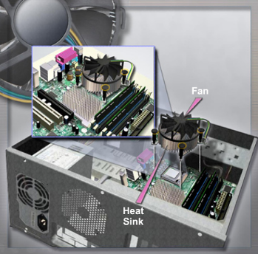
Upgrade and Configure CPU
CAUTION: Always work on an antistatic mat and wear a wrist strap when installing and removing CPUs.
Remove the existing CPU by releasing it from the socket using the zero insertion force lever.
Insert the new CPU into place.
  Single-Edge Connector (SEC)
  Low-Insertion Force (LIF)
  Zero-Insertion Force (ZIF)
  Land Grid Array (LGA) socket
Excessive force may damage
the CPU or its socket.
Notes:
11.4.2 Upgrade and configure a CPU and a heat sink/fan assembly
One way to increase the apparent power of a computer is to increase the processing speed. You can often do this by upgrading the CPU. However, there are some requirements that you must meet:
The new CPU must fit into the existing CPU socket.
The new CPU must be compatible with the motherboard chip set.
The new CPU must operate with the existing motherboard and power supply.
The new CPU must operate with the existing RAM. The RAM may need to be upgraded or expanded to take advantage of the faster CPU.
If the motherboard is older, you may not be able to find a compatible CPU. In that case, you would replace the motherboard.

Slide 29
Upgrade and Configure Heat Sink/Fan Assembly
The heat sink/fan assembly must:
  Physically fit the CPU
  Be compatible with the CPU socket.
  Be adequate to remove the heat of the faster CPU
CAUTION: You must apply thermal compound between the new CPU and the heat sink/fan assembly.
With some types of BIOS, you can view thermal settings to determine if there are any problems with the CPU and the heat sink/fan assembly.
Third-party software applications can report CPU temperature information in an easy to read format.
Notes:
11.4.2 Upgrade and configure a CPU and a heat sink/fan assembly

Slide 30
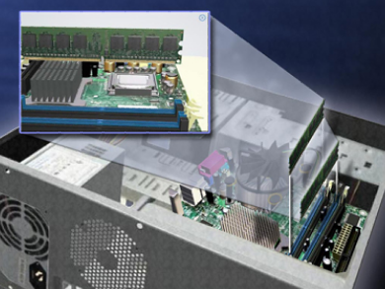
Upgrade and Configure RAM
CAUTION: Work on an antistatic mat. Wear a wrist strap.
Remove the existing RAM by freeing the retaining clips that secure it. Pull it from the socket.
Insert the new RAM, and lock it into place with the retaining clips.
The RAM should be
discovered by the
system.
If the BIOS does not
indicate the presence
of the correct amount
of RAM, troubleshoot.
Notes:
11.4.3 Upgrade and configure RAM
Increasing the amount of system RAM almost always improves overall system performance. Prior to upgrading or replacing the RAM, there are some questions you must answer:
What type of RAM does the motherboard currently use?
Can the RAM be installed one module at a time, or should it be grouped into matching banks?
Are there any available RAM slots?
Does the new RAM chip match the speed, latency, type, and voltage of the existing RAM?
CAUTION: Make sure to insert the memory module completely into the socket. RAM can cause serious damage to the motherboard if it is incorrectly aligned and shorts the main system bus.
The system discovers the newly installed RAM if it is compatible and installed correctly. If the BIOS does not indicate the presence of the correct amount of RAM, check to make sure that the RAM is compatible with the motherboard and is correctly installed.
Student Activity: The student course content includes two labs:
11.4.3 Lab: Install Additional RAM in Windows XP. To complete this lab, students will install additional RAM.
11.4.3 Lab: Install Additional RAM in Windows Vista. To complete this lab, students will install additional RAM.
Note: The Windows Vista labs include information covered in the CompTIA A+ certification and IT Essentials course chapter and final exams. These labs must be completed to prepare for the certification and course chapter and final exams. If the class does not have access to the Windows Vista operating system and compatible computer equipment, students must complete the labs using the provided screenshots.

Slide 31
Upgrade and Configure BIOS
Motherboard manufacturers periodically release updates for their BIOS. Read release notes for description of upgrade.
  “Flashing the BIOS" is upgrading the BIOS with new EEPROM, or flash memory.
  To view the current BIOS settings, enter the BIOS setup program.
    Press the setup sequence keys (possibly F1, F2, or Del key) while the computer is performing the power-on self test (POST).
  If you are unsure about changing a BIOS setting, then research the problem in depth.
  To download a new BIOS, go to the manufacturer's website and follow the installation procedures.
CAUTION: An improperly installed or aborted BIOS update can cause the computer to become unusable.
Notes:
11.4.4 Upgrade and configure BIOS
The first part of the boot process displays a message that tells you which key to press to enter the setup, or BIOS mode. There are a variety of settings in the BIOS that should not be altered by anyone unfamiliar with this procedure. If you are unsure, it is best not to change any BIOS setting unless you research the problem in depth.
Installing BIOS software online may involve downloading a new BIOS file, copying or extracting files to a floppy, and then booting from the floppy. An installation program prompts the user for information to complete the process.
Although it is still common to flash the BIOS through a command prompt, several motherboard manufacturers provide software on their websites that allow a user to flash the BIOS from within Windows. The procedure varies from manufacturer to manufacturer.
Student Activity: The student course content includes the lab, 11.4.4 BIOS File Search. To complete this lab, students will identify the current BIOS version, and then search for BIOS update files.

Slide 32
Upgrade and Configure Storage Devices and Hard Drives
Reasons for installing an additional drive:
  To install a second operating system
  To provide additional storage space
  To provide a faster hard drive
  To hold the system swap file
  To provide a backup for the original hard drive
  To increase fault tolerance
New partitions or drive letter assignments should be well-planned. The boot order in BIOS may need to be adjusted.
Notes:
11.4.5 Upgrade and configure storage devices and hard drives
Instead of purchasing a new computer to get increased access speed and storage space, you may consider adding another hard drive.
If the new drive is PATA and is on the same data cable, one of the drives must be set as the master drive and the other must be set as the slave drive. Each SATA hard drive has its own data cable; therefore, there is no master-slave relationship between drives. Also, any new partitions or drive letter assignments should be well-planned. The boot order in BIOS may need to be adjusted.

Slide 33
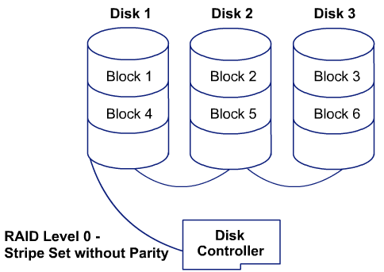
Types of RAID
Arrays, such as a redundant array of independent disks (RAID), improve fault tolerance when connecting multiple hard drives.
Install RAID using hardware or software.
  Hardware installations are usually more dependable, but more expensive.
Notes:
11.4.5 Upgrade and configure storage devices and hard drives
Some types of RAID require two or more hard drives. Software installations are created and managed by an operating system, such as Windows Server 2008.
Student Activity: The student course content includes two labs:
11.4.5 Lab: Install, Configure, and Partition a Second Hard Drive in Windows XP. To complete this lab, students will change the boot order, install a second hard drive, create partitions, and map drive letters to partitions.
11.4.5 Lab: Install, Configure, and Partition a Second Hard Drive in Windows Vista. To complete this lab, students will change the boot order, install a second hard drive, create partitions, and map drive letters to partitions.
Note: The Windows Vista labs include information covered in the CompTIA A+ certification and IT Essentials course chapter and final exams. These labs must be completed to prepare for the certification and course chapter and final exams. If the class does not have access to the Windows Vista operating system and compatible computer equipment, students must complete the labs using the provided screenshots.

Slide 34
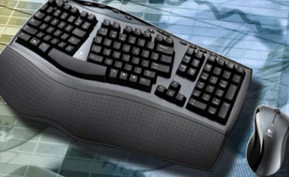
Upgrade and Configure I/O Devices
Reasons for installing new I/O devices:
  Replace a device that stopped operating properly
  Increase performance and/or productivity
  Add ergonomically designed devices
  Accommodate users with disabilities
When upgrading and configuring I/O devices, install new drivers, if necessary.
Notes:
11.4.6 Upgrade and configure input and output devices
Sometimes it is not possible to perform an upgrade using the existing expansion slots or sockets. In this case, you may be able to accomplish the upgrade using a USB connection. If the computer does not have an extra USB connection, you must install a USB adapter card or purchase a USB hub.
After obtaining new hardware, you may have to install new drivers.
NOTE: A signed driver is a driver that has passed the Windows hardware quality lab test and has been given a driver signature by Microsoft. Installing an unsigned driver can cause system instability, error messages, and boot problems. During hardware installation, if an unsigned driver is detected you will be asked to stop or continue installation of this driver.

Slide 35
Clean Internal Components
To remove dust, use compressed air to blow the dust away.
When using a can of compressed air, keep the can upright to prevent the fluid from leaking onto computer components.
While cleaning, inspect components for loose screws and connectors.
Keep these internal parts as clean as possible:
  Heat sink/fan assembly
  RAM
  Adapter cards
  Motherboard
  Case fan
  Power supply
  Internal drives
Notes:
11.5.1 Clean internal components
The amount of dust in the environment and the habits of the user determines how often to clean the computer components. Most of your cleaning is to prevent the accumulation of dust.
To remove dust, do not use a vacuum cleaner. Vacuum cleaners can generate static and can damage or loosen components and jumpers. Instead, you should use compressed air to blow the dust away. If you use compressed air from a can, keep the can upright to prevent the fluid from leaking onto computer components. Always follow the instructions and warnings on the compressed air can.
Regular cleaning also gives you a chance to inspect components for loose screws and connectors.
CAUTION: When you clean a fan with compressed air, hold the fan blades in place. This prevents over-spinning the rotor, or moving the fan in the wrong direction.

Slide 36
Clean the Computer Case
Dust buildup inside a computer can prevent the flow of air and affect cooling.
Use a cloth or duster to clean the outside of the computer case.
If using a cleaning product, put a small amount onto a cleaning cloth or duster and wipe the outside of the case.
Also, look for and fix these issues:
  Missing expansion slot covers that let dust, dirt, or living pests into the computer
  Loose or missing screws that secure adapter cards
  Missing or tangled cables that can pull free from the case
Notes:
11.5.2 Clean the case
Dirt can also enter a computer through missing expansion slot covers.
When using a cleaning product, do not spray it directly on the case. Instead, put a small amount onto a cleaning cloth or duster and wipe the outside of the case.

Slide 37
Inspect Computer Components
CPU and cooling system
  Examine for dust buildup.
  Check that the fan power cable is secure.
  Check the fan while the power is on to see the fan turn.
  Inspect the CPU to be sure that it is seated securely in the socket.
  Make sure that the heat sink is well attached.
CAUTION: Do not remove the CPU for cleaning.
RAM connections
  Ensure RAM chips are seated securely in the RAM slots. Sometimes the retaining clips can loosen.
  Use compressed air to remove any dust.
Notes:
11.5.3 Inspect computer components
The best method of keeping a computer in good condition is to examine the computer on a regular schedule. Cleaning provides a good opportunity to make this inspection.

Slide 38
Inspect Computer Components (Continued)
Storage devices
  Ensure all cables are firmly connected.
  Check for loose, missing, or incorrectly set jumpers.
  A drive should not produce rattling, knocking, or grinding sounds.
  Read the manufacturer's manual to learn how to clean optical drive and tape heads by using cotton swabs and compressed air.
  Clean floppy drives with a drive cleaning kit.
Adapter cards
  Ensure cards are seated properly.
  Secure cards with the retaining screw to avoid the cards coming loose in their expansion slots.
  Use compressed air to remove any dirt or dust on the adapter cards or the expansion slots.
Notes:
11.5.3 Inspect computer components
NOTE: The video adapter can sometimes become unseated because the large monitor cable can put pressure on it, or it is mishandled when someone is tightening the retainer screws.
NOTE: If a video adapter is used in an expansion slot, the integrated video adapter from the motherboard is likely to be disabled. If you connect a monitor to it in error, the computer appears not to work.

Slide 39
Inspect Computer Components (Continued)
Power devices, including power strips, surge suppressors (surge protectors), and UPS devices
  Ensure proper ventilation.
  Replace power strips if there have been electrical problems or excessive thunderstorms in the area.
Loose screws
  Can cause problems if not immediately fixed or removed.
Keyboard and mouse
  Use compressed air or a small vacuum cleaner to clean the keyboard and mouse.
  If the mouse is the mechanical type, remove the ball and clean off any dirt.
Cables
  Look for broken and bent pins.
  Ensure that all connector retaining screws are finger tight.
Notes:
11.5.3 Inspect computer components

Slide 40
Troubleshooting Process
Step 1 Identify the problem
Step 2 Establish a theory of probable causes
Step 3 Determine an exact cause
Step 4 Implement a solution
Step 5 Verify solution and full system functionality
Step 6 Document findings
Notes:
11.6 Troubleshoot computer components and peripherals

Slide 41
Step 1 - Identify the Problem
System information
  Manufacturer, model, OS, network environment, connection type
Open-ended questions
  Can you describe precisely what happens when the computer boots?
  How often does the computer fail to start?
  What is the first screen you see when you turn on your computer?
  What sounds does the computer make as it starts?
  Is there a pause, or does the computer restart instantly?
Closed-ended questions
  Has anyone done any repair work on the computer recently?
  Has anyone else used the computer?
  Does this computer have a floppy drive?
  Does this computer have a USB drive installed?
  Is there a wireless NIC in this computer?
  Is the computer turned off at night?
  Is the computer secured in a locked room at night?
  Do you have a Windows XP installation CD on hand?
Notes:
11.6.1 Review the troubleshooting process
Identify the Problem

Slide 42
Step 2 - Establish a Theory of Probable Causes
Problem may be simpler than the customer thinks.
Create a list of the most common reasons why the error would occur.
  Computer power problems
  Loose external cable connection
  Loose data cable connection
  Loose RAM
  Loose adapter card
  Incorrect device driver
  Incorrect RAM module
  Fans are dirty
  Incorrect jumper settings
  CMOS battery problem
  Incorrect firmware
Notes:
11.6.1 Review the troubleshooting process
Establish a Theory of Probable Causes

Slide 43
Step 3 - Determine the Exact Cause
Test your theories of probable causes one at a time, starting with the quickest and easiest.
  Restart the computer.
  Disconnect and reconnect the external cables.
  Disconnect and reconnect the internal cables.
  Secure the adapter card.
  Secure the RAM.
  Roll back or reinstall the device driver.
  Replace the RAM.
  Clean the fans.
  Reset the jumpers.
  Secure or replace the CMOS battery.
  Update the firmware.
If the exact cause of the problem has not been determined after you have tested all your theories, establish a new theory of probable causes and test it.
Notes:
11.6.1 Review the troubleshooting process
Determine the Exact Cause

Slide 44
Step 4 - Implement a Solution
If a quick procedure does not correct the problem, you might need to research the problem further to establish the exact cause.
Divide larger problems into smaller problems that can be analyzed and solved individually.
Create a list of possible solutions and implement them one at a time. If you implement a possible solution and it does not work, reverse the solution and try another.
Notes:
11.6.1 Review the troubleshooting process
Implement a Solution
If a quick procedure does correct the problem, you can go to step 5 to verify the solution and full system functionality.
Evaluate the problem and research possible solutions. Divide larger problems into smaller problems that can be analyzed and solved individually. Prioritize solutions starting with the easiest and fastest to implement.
Check:
Helpdesk repair logs
Other techs
Manufacturer FAQs
Technical websites
News groups
Computer manuals
Device manuals
Online forums
Internet search

Slide 45
Step 5 - Verify Solution and System Functionality
Verifying full system functionality and implementing any preventive measures if needed. This ensures that you have not created another problem while repairing the computer.
  Reboot the computer.
  Restart external drives.
  Access all drives and shared resources.
  Print a document.
  Read and write to all storage devices.
  Validate the amount of RAM, the CPU, speed, and the date and time.
Have the customer verify the solution and system functionality.
Notes:
11.6.1 Review the troubleshooting process
Verify Solution and System Functionality

Slide 46
Step 6 - Document Findings
Discuss the solution with the customer
Have the customer confirm that the problem has been solved
Give the customer all appropriate paperwork
Document the process in the work order and in your technician’s journal:
  Problem description
  Solution
  Components used
  Amount of time spent in solving the problem
Notes:
11.6.1 Review the troubleshooting process
Document Findings

Slide 47
Common Problems and Solutions
Computer problems can be attributed to hardware, software, networks, or some combination of the three. You will resolve some types of computer problems more often than others.
Notes:
11.6.2 Identify common problems and solutions
[Direct students to the chart (or charts) on the Identify common problems and solutions page in the course.]

Slide 48

Apply Troubleshooting Skills
It is time to apply your listening and diagnostic skills.
Notes:
11.6.3 Apply troubleshooting skills
Student Activity: The student course content includes the lab, 11.6.3 Repair Boot Problem. To complete this lab, students will troubleshoot and repair a computer that does not boot.
Student Activity: The student course content includes the lab, 11.6.3 Remote Technician: Repair Boot Problem. To complete this lab, students will gather data from the customer, and then instruct the customer on how to fix a computer that does not boot.
Student Activity: The student course content includes two labs:
11.6.3 Lab: Troubleshooting Hardware Problems in Windows XP. To complete this lab, students will diagnose the cause of various hardware problems and fix them.
11.6.3 Lab: Troubleshooting Hardware Problems in Windows Vista. To complete this lab, students will diagnose the cause of various hardware problems and fix them.
Note: The Windows Vista labs include information covered in the CompTIA A+ certification and IT Essentials course chapter and final exams. These labs must be completed to prepare for the certification and course chapter and final exams. If the class does not have access to the Windows Vista operating system and compatible computer equipment, students must complete the labs using the provided screenshots.

Slide 49
Chapter 11 Summary
Some of the important concepts to remember from this module:
You learned about the roles of the field, remote, and bench technicians and the job possibilities that are available to those who enter the workforce with some knowledge of advanced troubleshooting skills.
You are able to explain and perform safe lab procedures and tool use. You can describe basic electrical safety, especially as it applies to monitors and laser printers. You understand the purpose and enforcement of worker safety standards.
You know the safe disposal procedures for various types of computer batteries and types of hardware, such as monitors.
You have the ability to advise customers of ways to protect their computers by using good preventive maintenance practices.
You can describe ways to clean the external components of a computer, including the monitor, case, printer, and peripherals. You can describe how to clean internal components of a computer, such as the motherboard, CPU and cooling system, RAM, and adapter cards.
Notes:
Chapter 11 Summary

Slide 50
Chapter 11 Summary (Continued)
Some of the important concepts to remember from this module:
You know how to advise customers when it is best to upgrade a computer and components and when it is best to buy new products.
You can explain the steps involved in adding and configuring a second hard drive. You can describe the steps involved in updating various computer components, such as cases, power supplies, the CPU and cooling system, RAM, hard drives, and adapter cards.
You are able to demonstrate the use of open- and closed-ended questions that are appropriate for a level-two technician to determine the problem.
You can describe the troubleshooting steps, including gathering data from the customer, verifying obvious issues, trying quick solutions first, evaluating problems, and implementing solutions until the problem is fixed.
You have an understanding of the role of the level-two technician, and how to build on the troubleshooting efforts of a level-one technician.
Notes:
Chapter 11 Summary

Slide 51


